Slide 1
Comparative genomics of parasitic helminths
Steve Doyle
Wellcome Sanger Institute
LSHTM Pathogen Genomics 2021

Slide 2
Overview
Comparative genomics of the major parasitic worms
Evolutionary insight using chromosome-scale genomes
Shared parasite variation sheds light on adaption and migration

Slide 3
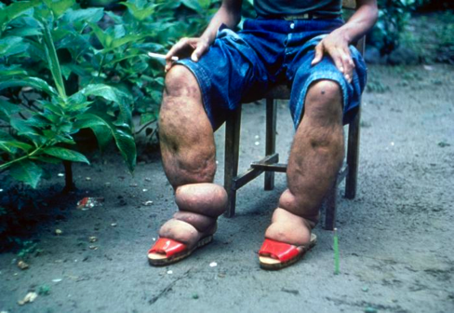
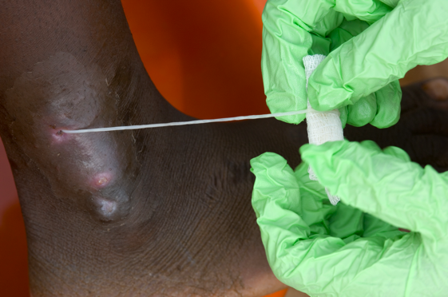
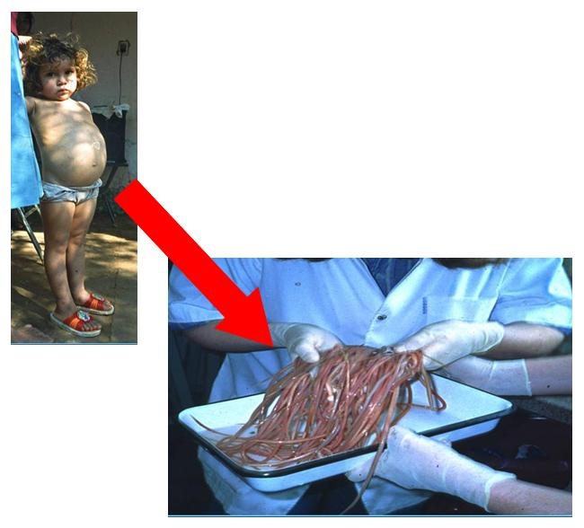
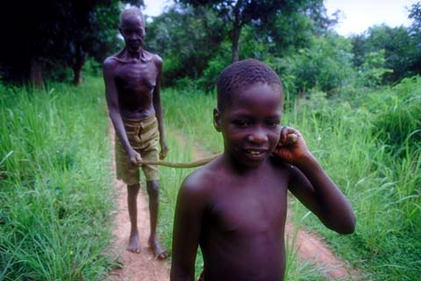
Comparative genomics of the major parasitic worms
Helminths represent a significant health and economic burdens on humans
(arguably) genomics has revolutionised our understanding of helminth biology
Lymphatic filariasis
Guinea worm
Onchocerciasis
Hookworms
Soil transmitted helminths
Gastrointestinal
nematodes

Slide 4
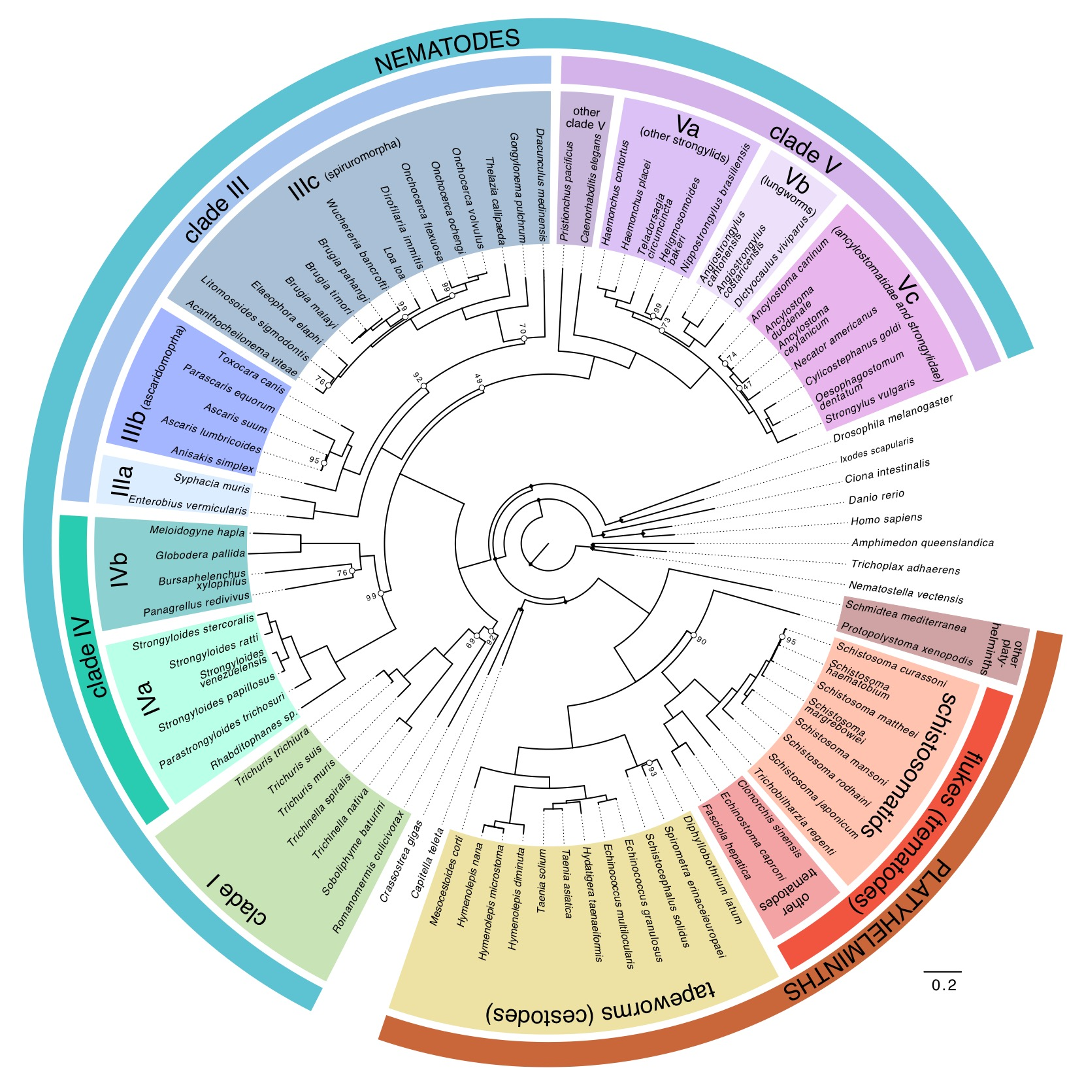
Comparative genomics of the major parasitic worms
50 Helminths Genome Project
1. To generate draft genome assemblies for:
clinically and veterinary important organisms
parasitic groups lacking exemplars in current genome projects
comparators to ‘reference’ species
2. (Try to) ensure similar sequencing, assembly and annotation approaches for each genome so they are truly comparable
Adapted from: Coghlan et al. (2019) Nature Genetics https://doi.org/10.1038/s41588-018-0262-1

Slide 5
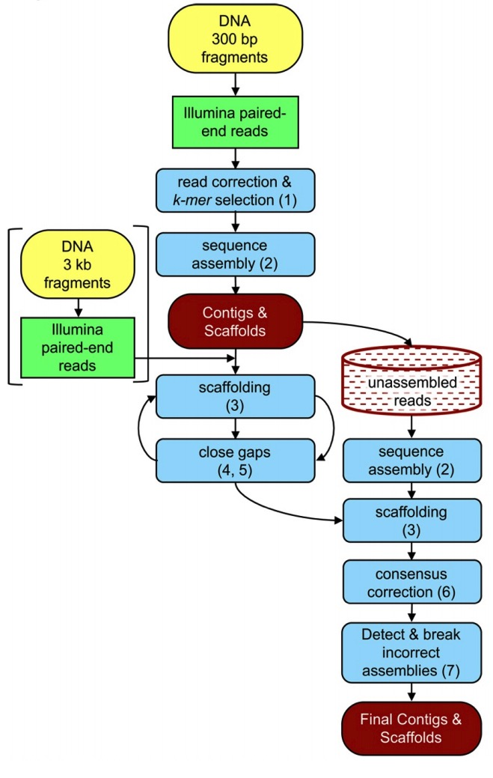
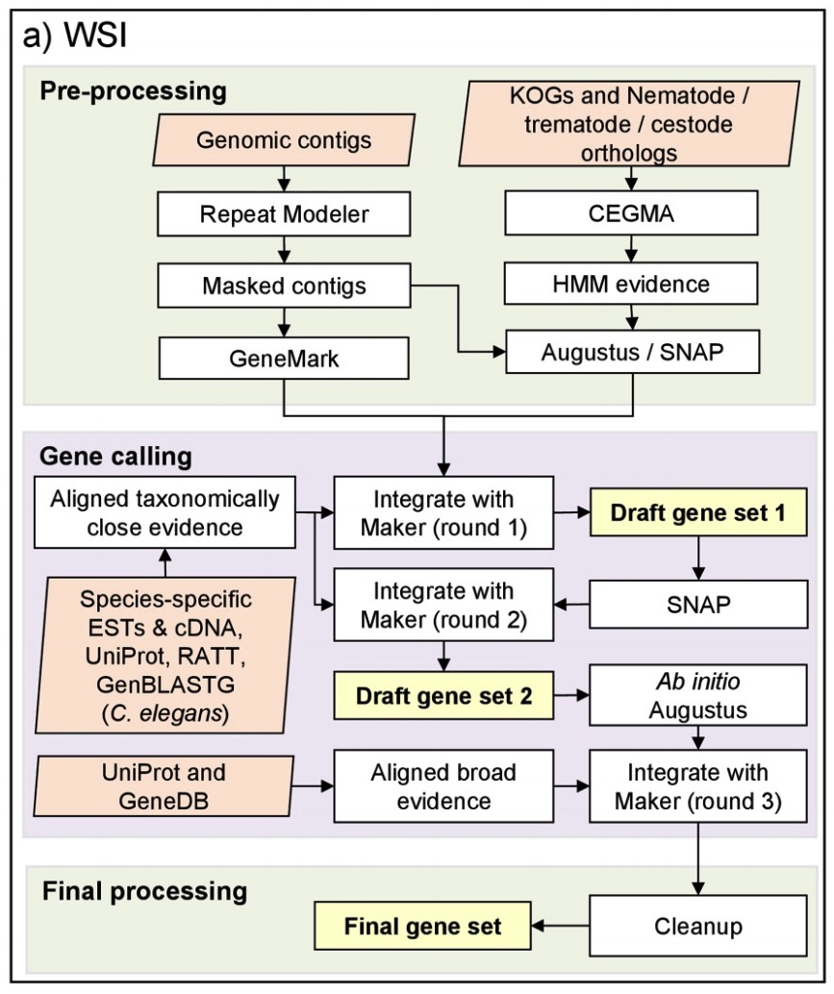
Comparative genomics of the major parasitic worms
Genome assembly
Genome annotation
Coghlan et al. (2019) Nature Genetics https://doi.org/10.1038/s41588-018-0262-1

Slide 6
Comparative genomics of the major parasitic worms
Genome size
42 to 700 Mb in nematodes
104 to 1,259 Mb in platyhelminths.
Genome content
>1.2 million protein coding genes
Highlights presence, absence, and expansions of gene families
Highly conserved pathways
Important for interactions with environment, including host
Candidate drug targets ->
Coghlan et al. (2019) Nature Genetics https://doi.org/10.1038/s41588-018-0262-1

Slide 7
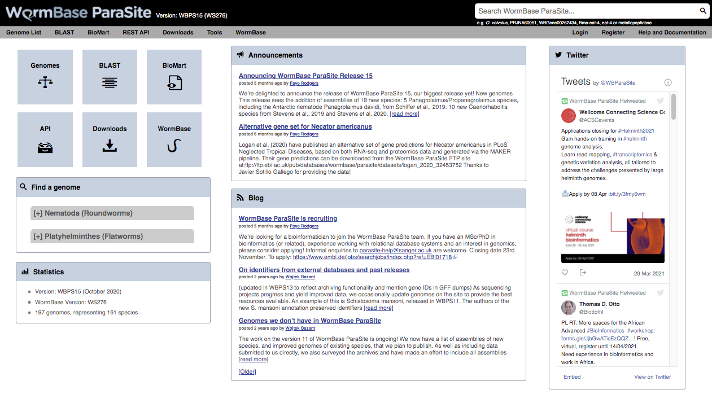
Comparative genomics of the major parasitic worms
https://parasite.wormbase.org/index.html

Slide 8
Evolutionary insight using chromosome-scale genomes
Draft genomes can provide broad overview of gene content
Chromosome-scale genomes offer additional insight into genome biology
Genome-wide context important for certain experiments
Haemonchus contortus

Slide 9
Haemonchus contortus: a major pathogen of ruminants
found worldwide in wild and domesticated ruminants
Adult worms inhabit the abomasum, and feed on blood
Drug resistance is common (very high frequency in some regions), including all major classes of anthelmintics

Slide 10
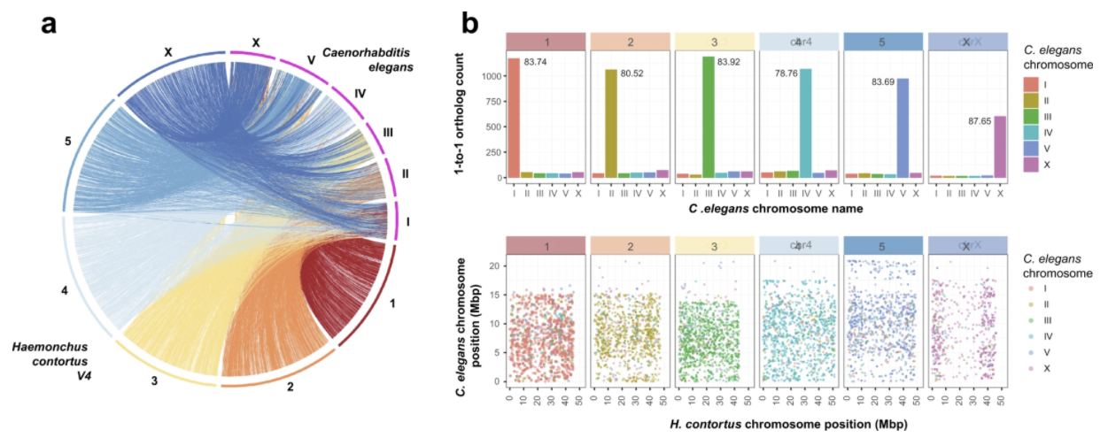
Evolutionary insight using chromosome-scale genomes
Doyle et al (2020) Communications Biology https://doi.org/10.1038/s42003-020-01377-3

Slide 11
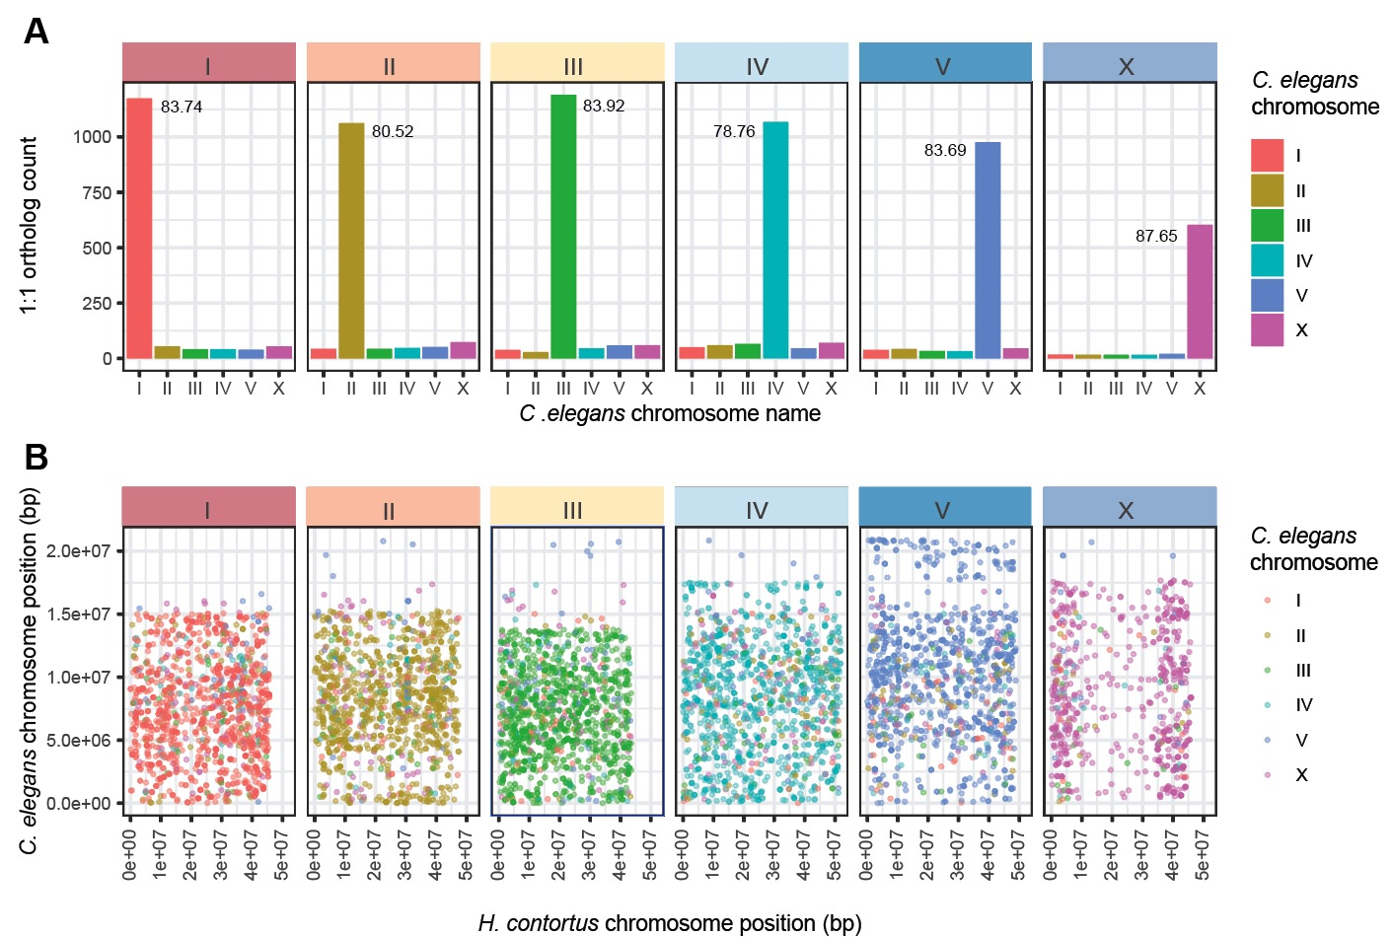
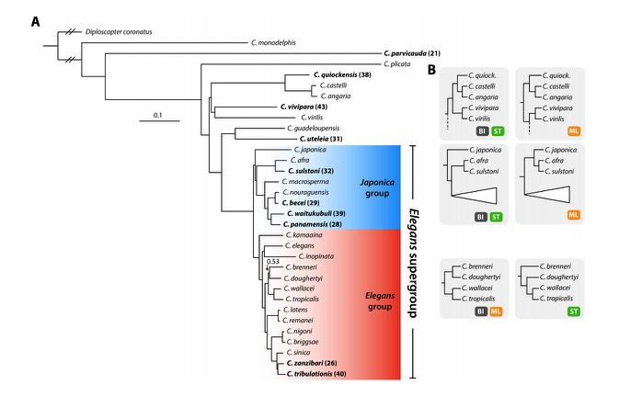
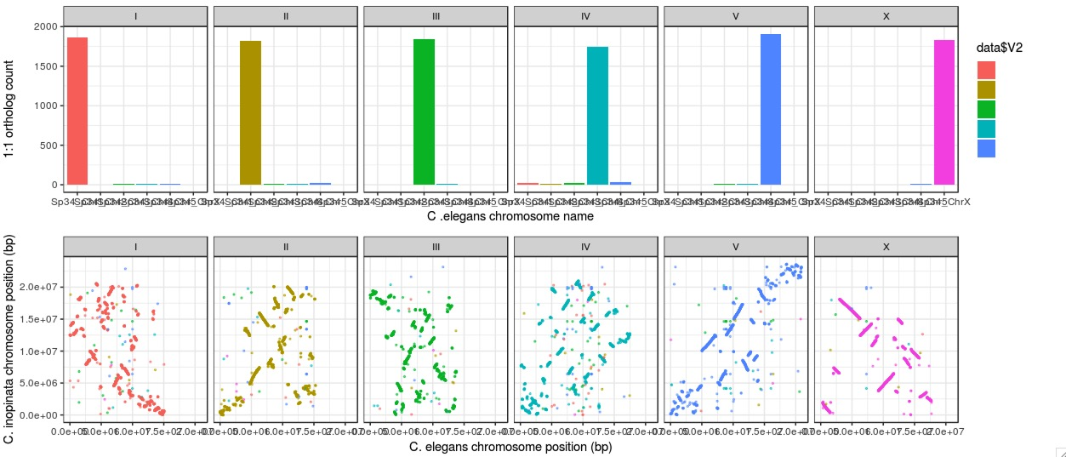
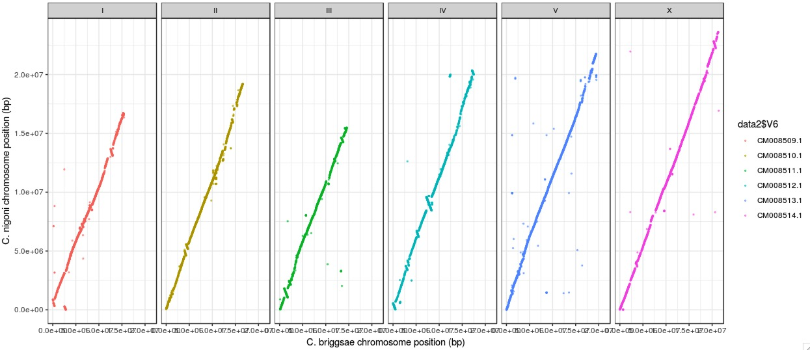
Evolutionary insight using chromosome-scale genomes
H. contortus vs C. elegans
C. elegans vs C. inopinata
C. nigoni vs C. briggsae
Stevens et al. (2019) Evolutionary Letters https://doi.org/10.1002/evl3.110

Slide 12
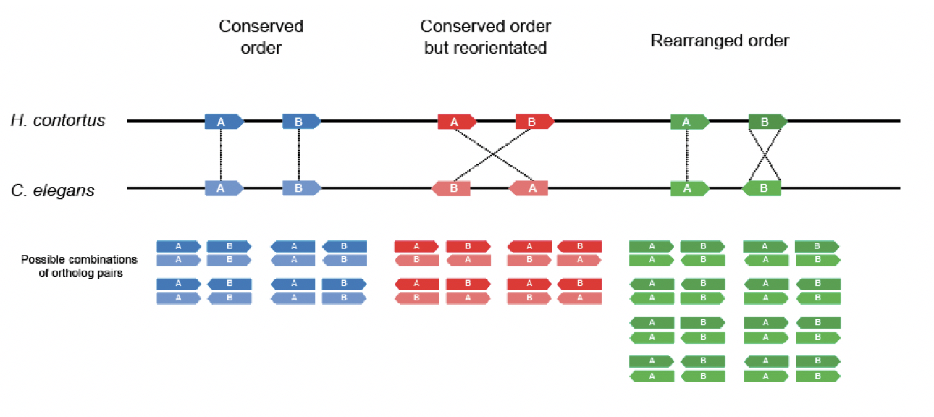
Evolutionary insight using chromosome-scale genomes
Doyle et al (2020) Communications Biology https://doi.org/10.1038/s42003-020-01377-3

Slide 13
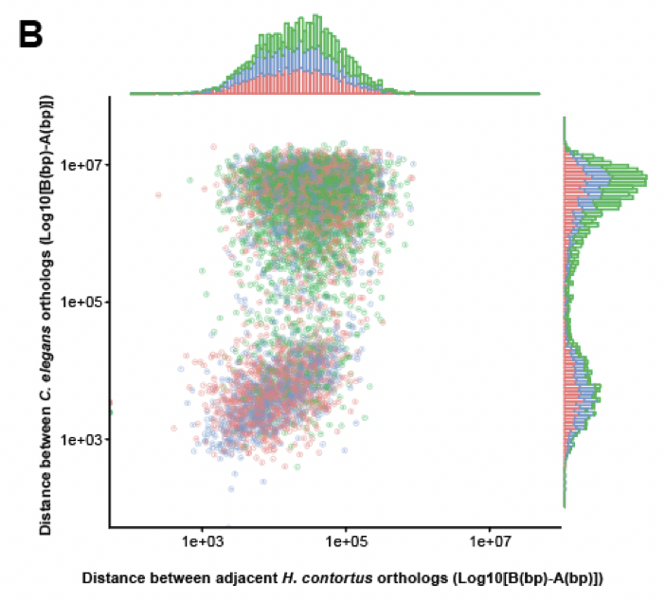
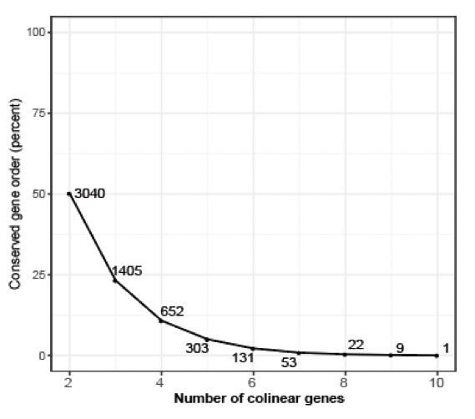
Evolutionary insight using chromosome-scale genomes
Doyle et al (2020) Communications Biology https://doi.org/10.1038/s42003-020-01377-3

Slide 14
Shared parasite variation sheds light on adaption and migration
Between species comparisons can tell us about deep evolutionary relationships
Within species variation can inform more recent selection / adaptation
How is genetic variation distributed among chromosomes?

Slide 15
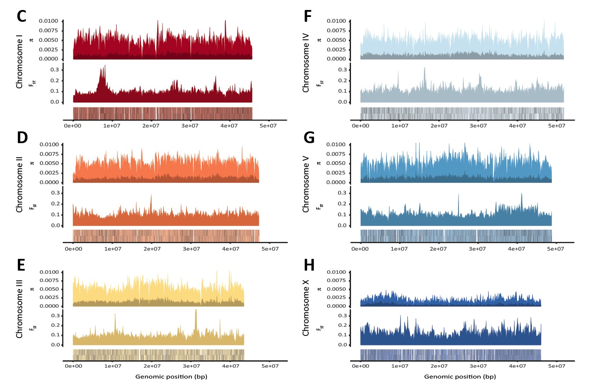
Shared parasite variation sheds light on adaption and migration
Whole genome sequencing of H. contortus:
- 338 samples from 35 populations
- ~20 million single nucleotide variants
Nucleotide diversity:
Between populations
Private to single population
Fst Between populations
Gene density (solid lines)
Doyle et al (2020) Communications Biology https://doi.org/10.1038/s42003-020-01377-3

Slide 16
Shared parasite variation sheds light on adaption and migration
Strong selective sweep around beta-tubulin isotype 1 locus
Nucleotide diversity:
Between populations
Private to single population
Fst Between populations
Gene density (solid lines)
Doyle et al (2020) Communications Biology https://doi.org/10.1038/s42003-020-01377-3

Slide 17
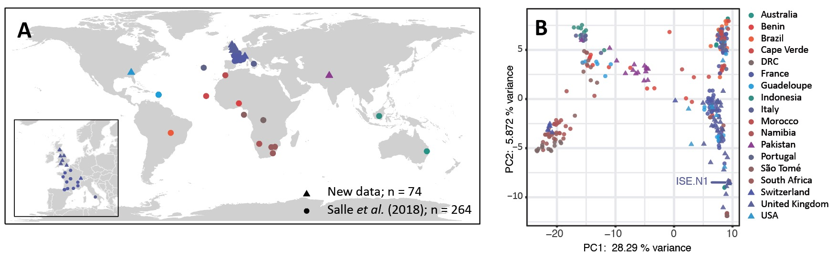
Shared parasite variation sheds light on adaption and migration
WGS: 338 samples from 35 populations
“Older” African diversity – South/Central
Modern European – spread broadly
Doyle et al (2020) Communications Biology https://doi.org/10.1038/s42003-020-01377-3

Slide 18
Shared parasite variation sheds light on adaption and migration
South Africa to Asia
Europe (France) to South America via Atlantic
South Africa toward Central / West Africa
West Africa to Americas
Doyle et al (2020) Communications Biology https://doi.org/10.1038/s42003-020-01377-3

Slide 19
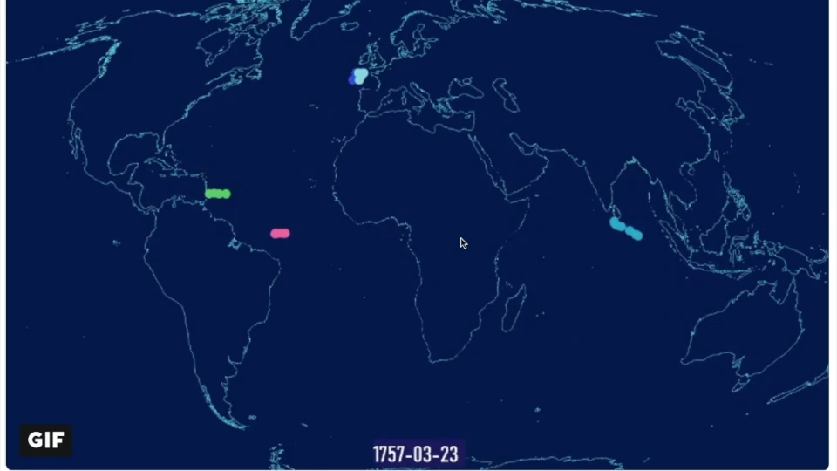
Shared parasite variation sheds light on adaption and migration
South Africa to Asia
Europe (France) to South America via Atlantic
South Africa toward Central / West Africa
West Africa to Americas

Slide 20
Comparative genomics of helminth parasites
Provides great insight into helminth biology
what makes a worm?
What allows a worm to become an effective parasite?
Helps describe deep evolutionary history
First genes, now chromosomes
Reconstructing divergence from last common ancestor
Understanding how/why chromosomes are structured
Genetic variation allows us to explore recent evolutionary events
Transmission, migration, recrudescence
Adaptation under pressure - drugs, climate

Slide 21









Acknowledgements
Matt Berriman
James Cotton
Nancy Holroyd
Alan Tracey
Guillaume Salle (INRAE)
Parasite Genomics
Group
Neil Sargison
Umer Chaudry
Eric Morgan
Hannah Rose
Katie Bull
Eileen Devaney
Roz Laing
Collette Britton
Louise Matthews
Jennifer McIntyre
Andy Tait
Barbara Mable
Kirsty Maitland
Dave Bartley
Alison Morrison
John Gilleard
Andrew Rezansoff
Libby Redman
Ray Kaplan
Sue Howell
Cath Milne
Chris Illingworth

